Slide 1
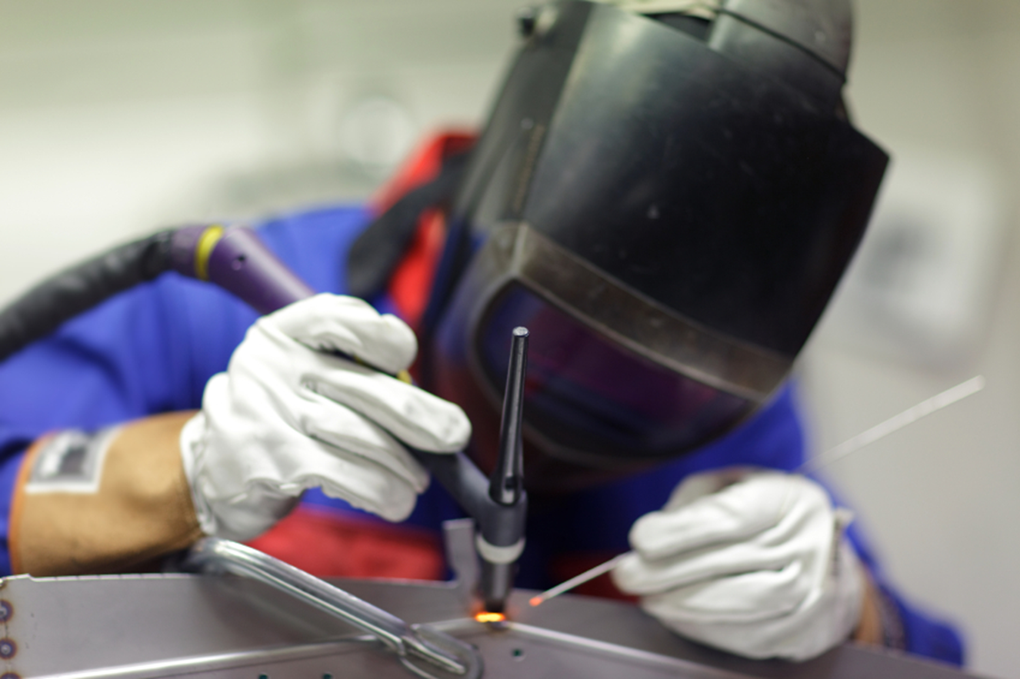
Welding
Rob Hendrickson, MD

Slide 2
Objectives
Welding processes
Potential toxicologic exposures
Potential toxicologic syndromes

Slide 3
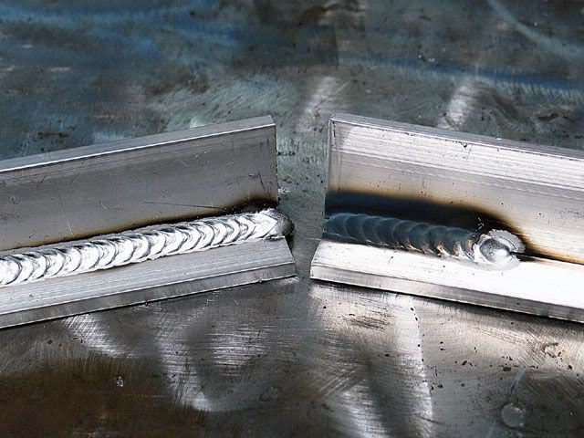
What is welding?

Slide 4
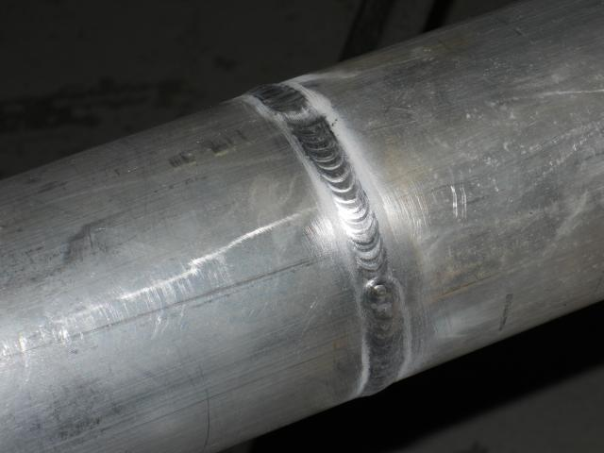
What is welding?

Slide 5

What is welding?
Joining pieces of metal together
  Melting both metals
Requires:
  Heat
  Filler metal
  Base metal

Slide 6
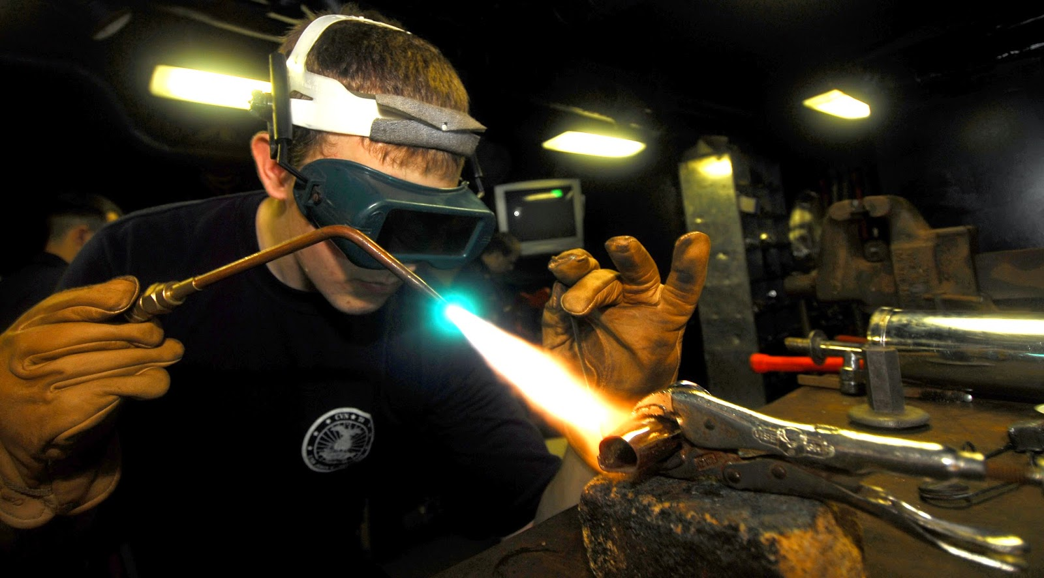
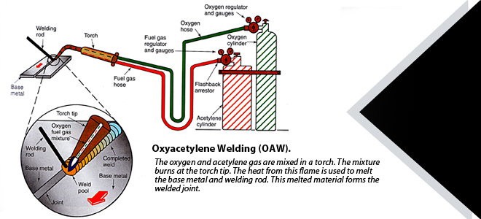
Types of welding
Gas welding
  Oxy-acetylene

Slide 7
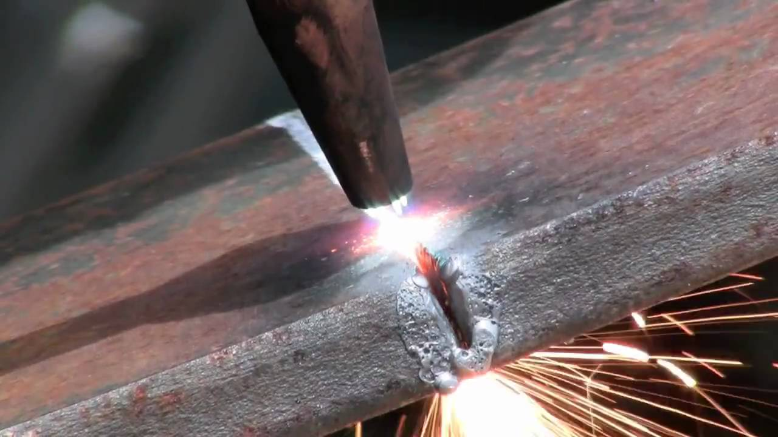
Types of welding
Gas welding
  Oxy-acetylene
  Cutting – high velocity oxygen

Slide 8
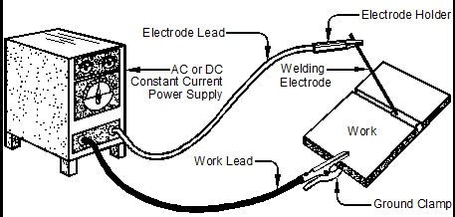
Types of welding
Arc welding

Slide 9
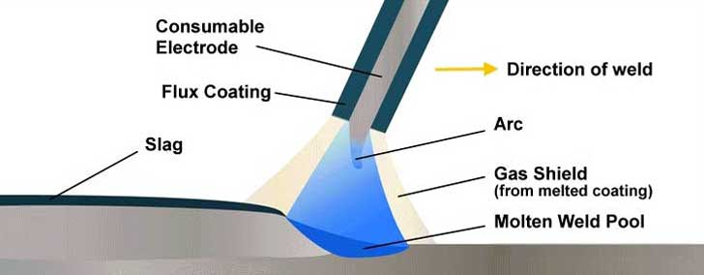
Types of welding
Arc welding
  Manual metal arc welding (MMA); stick welding
    Consumable stick electrode

Slide 10
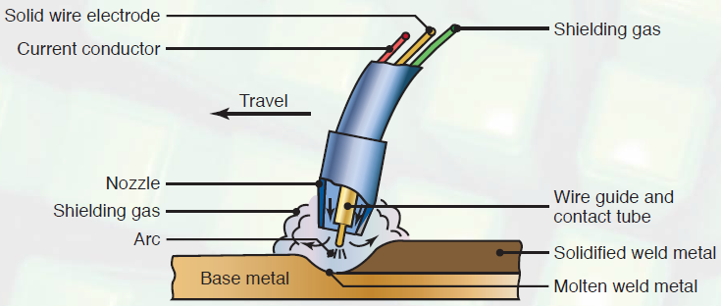
Types of welding
Arc welding
  Manual metal arc welding (MMA); stick welding
  Gas metal arc welding
    Metal inert gas (MIG)
    Tungsten inert gas (TIG)

Slide 11

Other stuff
Flux
  Cleaning agent
  Coating on electrode (filler metal)
Notes:
Reducing agents

Slide 12

Other stuff
Shielding
  Inert gas – helium, argon, CO₂
Notes:
Reducing agents

Slide 13
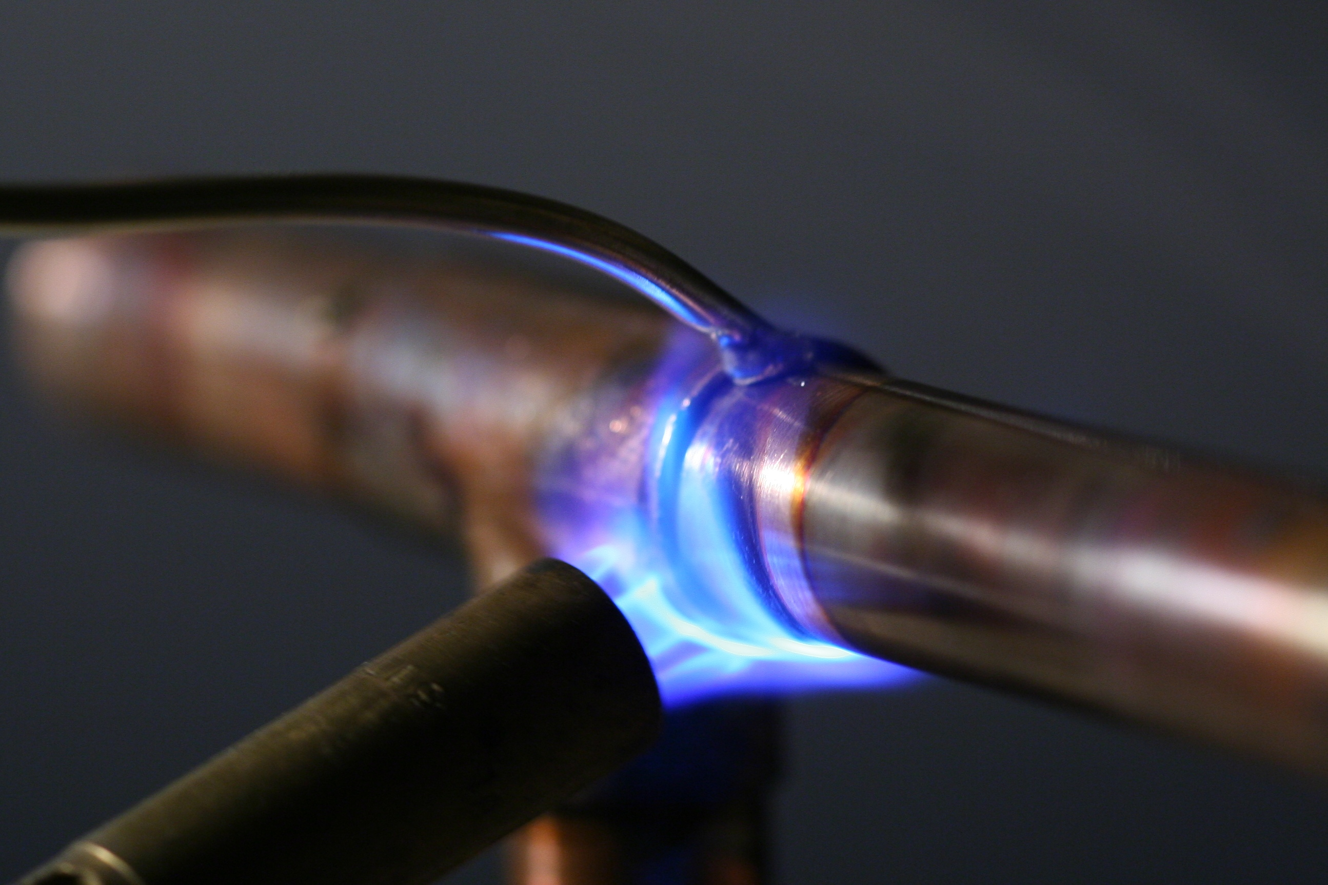
Joining methods
Lower temperature processes:
  Soldering
  Brazing

Slide 14
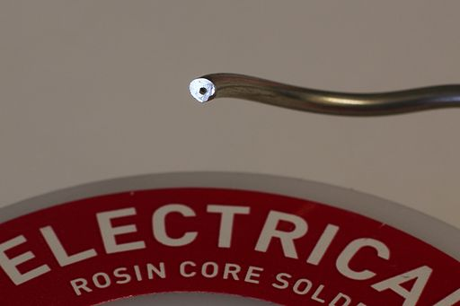
Joining methods
Flux
  Rosin (colophony; pine resin; allergenic)
  Acids

Slide 15
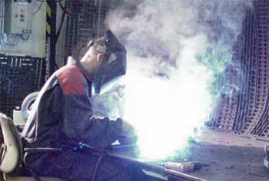
Exposures
In addition to retinal, vibrational, electrical, etc, hazards
Inhalational
Welding plume
  Metal fumes

Slide 16
Exposures
Steel – iron oxide, zinc oxide, chromium
Filler rods – lead, copper, zinc, silver, cadmium, magnesium, manganese
Flux – acids, rosin

Slide 17
Health effects
Inhalational exposures
  Metal fume fever
  Polymer fume fever
  Chemical pneumonitis
  Hypersensitivity pneumonitis
  Pulmonary pneumoconiosis / fibrosis
  Occupational asthma
  Lung cancer?

Slide 18
Metal fume fever
Zinc, copper, manganese, chromium, iron, and nickel
Fume – solid particles, <1 micrometer
Delayed (4-10 hours) inflammatory reaction
“welder’s ague”, “brass chills”, “zinc fever”, “metal shakes”

Slide 19
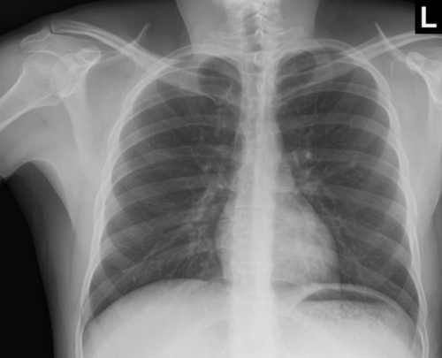
Metal fume fever
Delayed (4-10): flu like symptoms
CXR normal
Resolves in 12-48 hours
Cause:
  Delayed hypersensitivity
  Sensitization
  Hapten/zinc-protein conjugate
  Cytokine release
  Neutrophil activation
Notes:
1974 – 31% of welders reported getting MFF

Slide 20
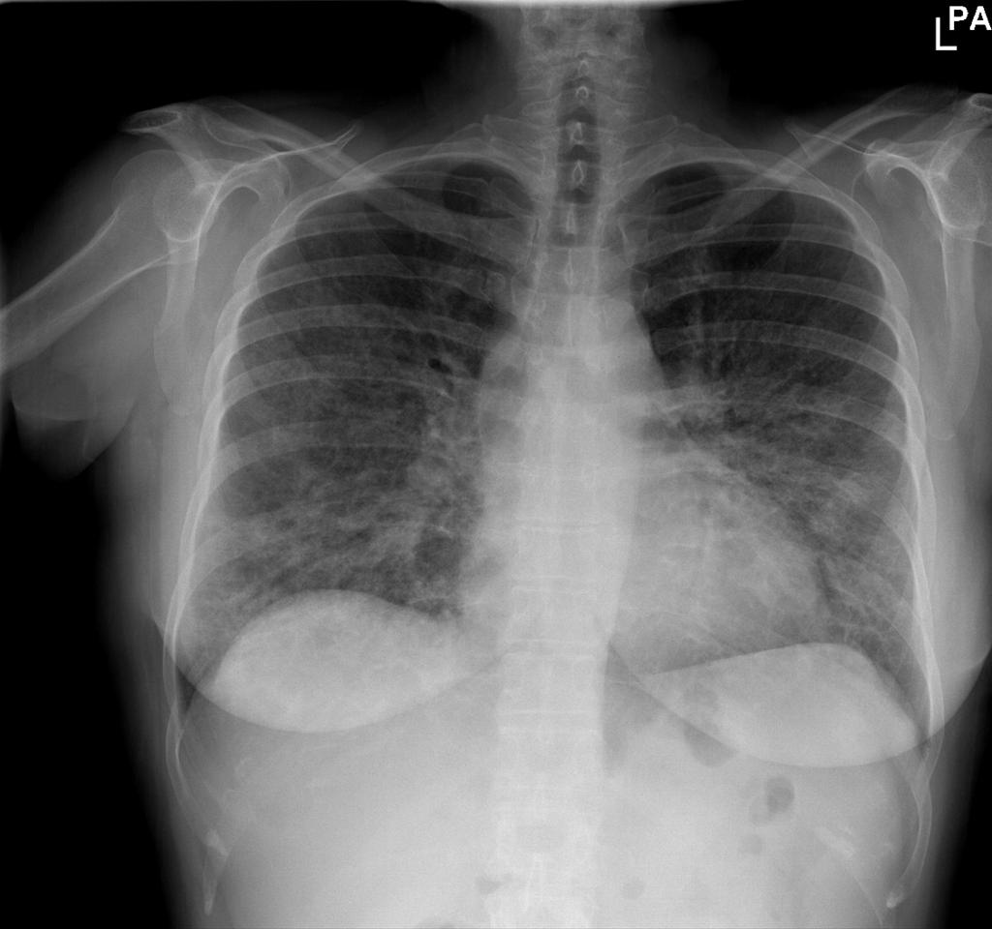
Cadmium pneumonitis
Copper soldering/brazing
Cadmium-containing filler rods
Initially looks like metal fume fever
Then, develop pneumonitis
20% develop fibrosis
  Restrictive PFT
Notes:
1974 – 31% of welders reported getting MFF

Slide 21

Chemical pneumonitis
Cadmium
Other irritants:
  Ozone
  Nitrogen dioxide
Notes:
1974 – 31% of welders reported getting MFF

Slide 22
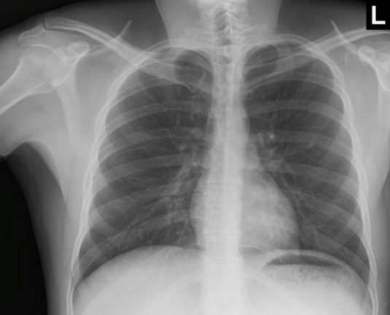
Polymer fume fever
Pyrolyzed Teflon (polytetrafluoroethylene)
Similar to MFF
  Delayed onset (4-10 hours)
  Flu-like symptoms
  Generally have normal CXR
  Resolves over 12-48 hours
Notes:
1974 – 31% of welders reported getting MFF

Slide 23
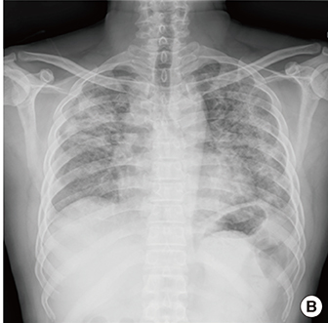
Hypersensitivity pneumonitis
Requires pre-exposure
Generally recurrent and increasing in severity
Cough, dyspnea, leukocytosis, diffuse infiltrates
May be variety of substances in welding plume
  Rosin
Notes:
1974 – 31% of welders reported getting MFF

Slide 24
Occupational asthma/COPD
Reversible obstructive PFTs
Rates of asthma low in welders (healthy worker effect?)
Asthma associated with rosin aminoethyl ethanolamine used in solder flux
Notes:
1974 – 31% of welders reported getting MFF

Slide 25
Lung cancer
Association of welding and lung cancer
IARC – welding fumes
  “possibly carcinogenic in humans”
  Confounders: cigarette smoking, asbestos
Arc welding of stainless steel generates hexavalent chromium (known human carcinogen)
Notes:
1974 – 31% of welders reported getting MFF

Slide 26
Occupational monitoring
Depends on the likely exposure
Initial
  History, physical examination
  Cadmium:
    Initial UCd, BCd, beta2 microglobulin
    At least annual
  Zinc:
    Initial CXR and PFTs
    At least annual
Notes:
1974 – 31% of welders reported getting MFF

Slide 27
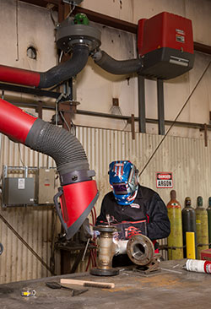
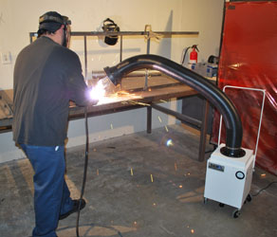
Occupational safety
OSHA requires “Hazard Communication” for all employees
  Worker position to avoid inhalation, e.g upwind
  Ventilation – outdoors, exhaust systems
Notes:
1974 – 31% of welders reported getting MFF

Slide 28
Occupational safety
OSHA requires “Hazard Communication” for all employees
  Worker position to avoid inhalation, e.g upwind
  Ventilation – outdoors, exhaust systems
  Respiratory protection
    If airborne concentrations are above action levels set by OSHA
Notes:
1974 – 31% of welders reported getting MFF

Slide 29
Welding
Melting metal
Exposures to metal fumes, inhalational
Lung toxicities: fume fevers, pneumonitides
Possibility of occupational asthma and lung cancer
Protection – control of welding fumes
Notes:
1974 – 31% of welders reported getting MFF

Slide 30


Questions and discussion…

